Slide 1
Drug and Alcohol Testing Trends: MIS Reporting Michael Redington US DOT Volpe Center FTA Drug and Alcohol Program National Conference May 13, 2021

Slide 2
Speaker
Michael Redington – US DOT Volpe Center, Cambridge, MA

Slide 3
Regulations
49 CFR Part 655.72:
Annually “prepare and maintain” summary
Submit – when requested (March 15th)
Recipient must:
Be responsible
Ensure accuracy
Ensure timeliness
For each report submitted (Employer, Contractor, Third Party, Consortium, Joint Enterprise)
49 CFR PART 40.26:
Use form in Appendix of Part 40

Slide 4
Notification
Notification Letter to FTA Grantees:
Late December
Attention: Certifying Official
Username & Password
Instructions
Link to DAMIS (http://damis.dot.gov)
Contractors and subrecipients
Where to find instructions & assistance

Slide 5
FAQs
For what time period do I report?
What if my fiscal year is not the calendar year?
What if we ran service for only a portion of the year?
Does the username & password change?
How do my contractors and subrecipients receive their usernames & passwords?
Who is the Certifying Official?

Slide 6
FAQs
Do I report all drug & alcohol test results for the CY?
Do I report all DOT drug & alcohol test results for the CY?
Two of my contractors are in the same random pool, can I submit one MIS report?
I am the FTA Grantee, but have no FTA D&A Program – do I submit?
Do I report a pre-employment test when the applicant was not hired?

Slide 7
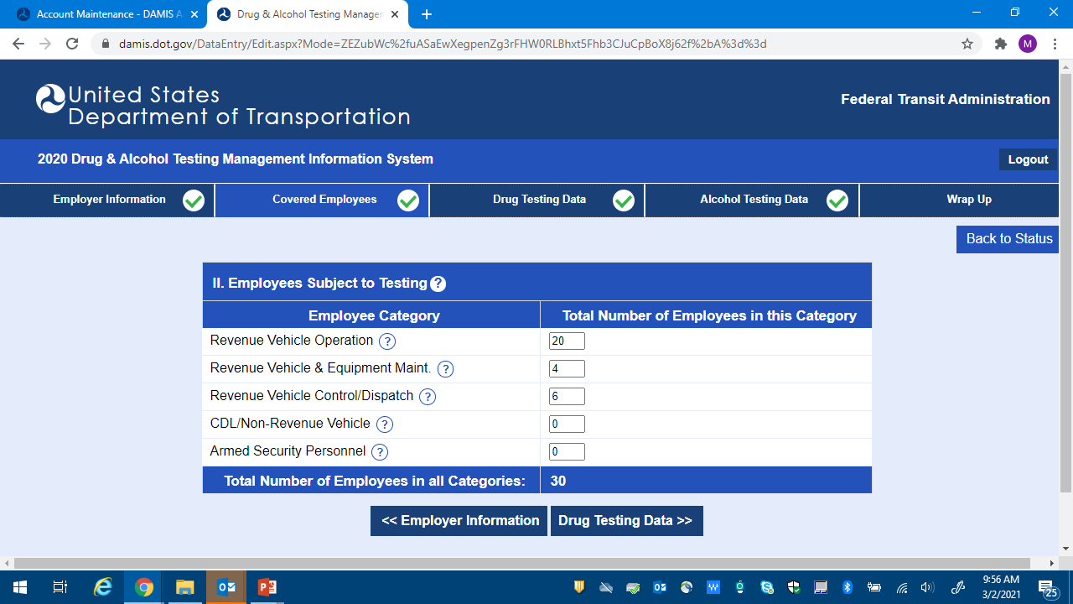
Number of Covered Employees (Employees Subject to Testing)
HOW TO CALCULATE

Slide 8
Calculate: Number of Covered Employees (Employees Subject to Testing)
Average number of FTA-covered employees in your random testing pool(s), at the time of the random selection:
Example – using quarterly random selections
1st Quarter = 27
2nd Quarter = 25
3rd Quarter = 34
4th Quarter = 34
TOTAL = 120 FTA-Covered Employees / 4 Quarters = 30
30 = “Total Number of Employees in All Categories”

Slide 9
DAMIS https://damis.dot.gov
Logging in
No math required –Totals (left-most column)
Entering zeroes
Warnings messages
Error messages
How to submit

Slide 10
FAQs II
How do I report if a CCF is checked FMCSA, but should be FTA?
What if all my CCFs are incorrectly checked FMCSA?
What do I report if an employee was randomly selected, but not tested?
How do I report that a contractor started mid-year?
How do I calculate the number of random tests?

Slide 11
FAQs II
What if the MRO cancelled a test and required a recollection?
Where is an employee counted if they work as RVO and Dispatcher?
What if an employee is part-time?

Slide 12
General Reporting Rules
Report what actually happened:
If incorrectly conducted a non-DOT test and did not upgrade – Do not report it
Report the final result.
Do not double report any test result.
Do not report same test result to multiple DOT agencies.

Slide 13
Compile Data for MIS
Results come from ATF, CCF and MRO Results:
Do not use semi-annual lab report
Certifying/Company Official is Responsible:
Ensure accuracy
TPA may complete report – Company Official must certify it.

Slide 14
Common Errors
Do not list Consortium or TPA
Submit contractor data under Grantee when Grantee is a pass-through
Report non-events as cancelled tests
Include FMCSA tests results on FTA report
Do not report all safety-sensitive contractors
Submit late

Slide 15
Uses of Data
Determine compliance with 49 CFR Part 655
Determine FTA annual random minimum testing rates
DOT Public Drug and Alcohol Testing Database
Https://www.Transportation.Gov/odapc/dot_agency_mis_data
Audit determination, scheduling and logistics
Identify trends of drug and alcohol use in transit
Assist in determining training needs
Newsletter articles, technical assistance tools, etc.

Slide 20
2019/2020 Random Drug Positive Rate - FTA Regions

Slide 21
Questions
Michael Redington US DOT Volpe Center 617-494-2197 michael.redington@dot.gov
FTA Drug and Alcohol Hotline 617-494-6336 fta.damis@dot.gov

