Slide 1
Post-Accident Testing Thresholds & Scenarios Trent Fontanella Cahill Swift FTA Drug and Alcohol Program National Conference May 13, 2021

Slide 2
Speaker
Trent Fontanella – Cahill Swift, Boston, MA

Slide 3
What is an accident?

Slide 4
What is an Accident?
655.4 Definitions
Accident means an occurrence associated with the operation of a vehicle, if as a result:
An individual dies; or
An individual suffers bodily injury and immediately receives medical treatment away from the scene of the accident; or
With respect to an occurrence in which the mass transit vehicle involved is a bus, electric bus, van, or automobile, one or more vehicles (including non-FTA funded vehicles) incurs disabling damage as the result of the occurrence and such vehicle or vehicles are transported away from the scene by a tow truck or other vehicle; or
With respect to an occurrence in which the public transportation vehicle involved is a rail car, trolley car, trolley bus, or vessel, the public transportation vehicle is removed from operation.

Slide 5
What is an Accident?
655.4 Definitions
Accident means an occurrence associated with the operation of a vehicle.
Transit vehicle:
Revenue service vehicle
Transports passengers
Non-revenue service transit vehicle that requires CDL to operate
Revenue service vehicle with no passengers
Supervisor vehicle that does not transport passengers
Vehicle used only by security officer

Slide 6
What is an Accident?
655.4 Definitions
Accident means an occurrence associated with the operation of a vehicle.
An incident related to any type of operation of the vehicle:
Not conditional on vehicle moving, a vehicle “crash”, or location of vehicle
Includes vehicle equipment not directly related to movement of vehicle (lift)
Incident occurs in transit parking lot
Loading passenger using wheelchair lift
Passenger falls when bus driver takes sharps turn
Operation of the vehicle was related to the occurrence
Passenger has heart attack when loading the bus
Operation of the vehicle was not related to the occurrence

Slide 7
What is an Accident?
655.4 Definitions
Accident means an occurrence associated with the operation of a vehicle, if as a result:
(1) An individual dies;
Death of any individual:
Transit vehicle passenger or driver
Passenger of another vehicle involved in the accident
Pedestrian
Death of animal

Slide 8
What is an Accident?
655.4 Definitions
Accident means an occurrence associated with the operation of a vehicle, if as a result:
(2) An individual suffers bodily injury and immediately receives medical treatment away from the scene of the accident
Immediately travels from incident scene to place of treatment.
Not contingent on ambulance transport
Does not specify type of treatment facility
Individual immediately drives themself to primary care doctor’s office
Paramedic provides basic on-site treatment (bandage, ice pack)
Individual decides to go to urgent care later that day

Slide 9
What is an Accident?
655.4 Definitions
Accident means an occurrence associated with the operation of a vehicle, if as a result:
(3) With respect to an occurrence in which the mass transit vehicle involved is a bus, electric bus, van, or automobile, one or more vehicles (including non-FTA funded vehicles) incurs disabling damage as the result of the occurrence and such vehicle or vehicles are transported away from the scene by a tow truck or other vehicle.

Slide 10
What is an Accident?
655.4 Definitions
Disabling damage means damage that precludes departure of a motor vehicle from the scene of the accident in its usual manner in daylight after simple repairs.

Slide 11
What is an Accident?
655.4 Definitions
Disabling damage means damage that precludes departure of a motor vehicle from the scene of the accident in its usual manner in daylight after simple repairs.
Vehicle cannot be driven; or
Vehicle could be driven, but would be further damaged if driven:
Cosmetic damage
Malfunctioning accessory, safety feature, technology, etc. that does not physically prevent vehicle from being driven (even if employer policy prohibits driving vehicle until repaired)

Slide 12
What is an Accident?
655.4 Definitions
Disabling damage means damage that precludes departure of a motor vehicle from the scene of the accident in its usual manner in daylight after simple repairs.
Not disabling if damage can be remedied temporarily at scene of accident without special tools or parts (even if repairs are not made at scene).
Disabling damage is not:
Tire disablement without other damage even if no spare tire is available
Damage to headlamp, taillight, turn signal, horn, windshield wiper

Slide 13
What is an Accident?
Disabling damage means damage that precludes departure of a motor vehicle (bus, electric bus, van, or automobile) from the scene of the accident in its usual manner in daylight after simple repairs.
Inclusion:
Damage to a motor vehicle, where the vehicle could have been driven, but would have been further damaged if so driven.
Exclusions:
Damage that can be remedied temporarily at the scene of the accident without special tools or parts.
Tire disablement without other damage even if no spare tire is available.
Headlamp or tail light damage.
Damage to turn signals, horn, or windshield wipers, which makes the vehicle inoperable.

Slide 14
What is an Accident?
655.4 Definitions
Accident means an occurrence associated with the operation of a vehicle, if as a result:
(3) With respect to an occurrence in which the mass transit vehicle involved is a bus, electric bus, van, or automobile, one or more vehicles (including non-FTA funded vehicles) incurs disabling damage as the result of the occurrence and such vehicle or vehicles are transported away from the scene by a tow truck or other vehicle.
Disabling damage to any vehicle involved in the occurrence:
Non-FTA funded revenue service vehicle
Non-transit car

Slide 15
What is an Accident?
655.4 Definitions
Accident means an occurrence associated with the operation of a vehicle, if as a result:
(3) With respect to an occurrence in which the mass transit vehicle involved is a bus, electric bus, van, or automobile, one or more vehicles (including non-FTA funded vehicles) incurs disabling damage as the result of the occurrence and such vehicle or vehicles are transported away from the scene by a tow truck or other vehicle.
Vehicle transported away from scene must also have disabling damage.

Slide 16
What is an Accident?
655.4 Definitions
Accident means an occurrence associated with the operation of a vehicle, if as a result:
(4) With respect to an occurrence in which the public transportation vehicle involved is a rail car, trolley car, trolley bus, or vessel, the public transportation vehicle is removed from operation.
Vehicle must be taken out of service; no tow is required.
“Disabling damage” is not applicable in these incidents.

Slide 17
What is an Accident?
Occurrence associated with the operation of a vehicle, if as a result:
Human fatality
Bodily injury and immediate medical treatment
Disabling damage
Bus, electric bus, van, automobile
Removal from service
Rail car, trolley car, trolley bus, vessel

Slide 18
When & Who to Test

Slide 19
When and Who to Test
§655.44 (a)(1) Fatal accidents
As soon as practicable following an accident involving the loss of human life, an employer shall conduct drug and alcohol tests on each surviving covered employee operating the public transportation vehicle at the time of the accident.
Post-accident drug and alcohol testing of the operator is not required under this section if the covered employee is tested under the fatal accident testing requirements of the Federal Motor Carrier Safety Administration rule 49 CFR 389.303(a)(1) or (b)(1).
The employer shall also drug and alcohol test any other covered employee whose performance could have contributed to the accident

Slide 20
When and Who to Test
655.44 Fatal Accidents
As soon as practicable following an accident involving the loss of human life, an employer shall conduct drug and alcohol tests on each surviving covered employee operating the public transportation vehicle at the time of the accident.
Operator(s) must be drug and alcohol tested:
Supervisor or other employee(s) on vehicle not necessarily tested, however… (to be continued)

Slide 21
When and Who to Test
655.44 Fatal Accidents
The employer shall also drug and alcohol test any other covered employee whose performance could have contributed to the accident, as determined by the employer using the best information available at the time of the decision.
Who else could have contributed?
On-board supervisor training employee
Maintenance worker who last worked on bus
Dispatcher who directed driver to go wrong direction on one-way street

Slide 22
When and Who to Test
655.44 Fatal Accidents
The employer shall also drug and alcohol test any other covered employee whose performance could have contributed to the accident, as determined by the employer using the best information available at the time of the decision.
Employer (supervisor, DAPM, etc.) makes determination.
Not police, insurance, etc.
Decision to test is made promptly, using information available at time of event.
Do not base testing decision on prolonged investigation

Slide 23
When and Who to Test
655.44 Fatal Accidents
Post-accident drug and alcohol testing of the operator is not required under this section if the covered employee is tested under the fatal accident testing requirements of the Federal Motor Carrier Safety Administration.
Applicable to employees that perform both FMCSA and FTA regulated work.
Do not test twice.

Slide 24
When and Who to Test
§655.44 (a)(2) Nonfatal accidents
As soon as practicable following an accident not involving the loss of human life in which a public transportation vehicle is involved, the employer shall drug and alcohol test each covered employee operating the public transportation vehicle at the time of the accident unless the employer determines, using the best information available at the time of the decision, that the covered employee's performance can be completely discounted as a contributing factor to the accident.
The employer shall also drug and alcohol test any other covered employee whose performance could have contributed to the accident, as determined by the employer using the best information available at the time of the decision.

Slide 25
When and Who to Test
655.44 Nonfatal accidents
Each covered employee operating the public transportation vehicle at the time of the accident unless the employer determines, using the best information available at the time of the decision, that the covered employee's performance can be completely discounted as a contributing factor to the accident.
Decision should be made promptly.
Video footage may be used, if viewable in real time
Remote decision-making allowable

Slide 26
When and Who to Test
655.44 Nonfatal accidents
Each covered employee operating the public transportation vehicle at the time of the accident unless the employer determines, using the best information available at the time of the decision, that the covered employee's performance can be completely discounted as a contributing factor to the accident.
Testing must occur unless the employee is completely discounted as a contributing factor.
Not contingent on being held responsible by police, insurance, or etc.
May not have blanket policy to always FTA test after every nonfatal accident.

Slide 27
When and Who to Test
Fatal accident:
All employees operating the vehicle
Any covered employee that could have contributed
Nonfatal accident:
All employees operating the vehicle, unless their performance can be completely discounted as a contributing factor
Any covered employee that could have contributed

Slide 28
When and Who to Test

Slide 29
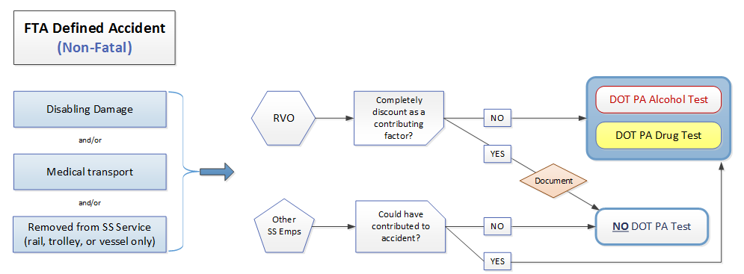
When and Who to Test

Slide 30
When and Who to Test
Important Takeaways
Supervisor (or other decision maker) is empowered to make post-accident testing decisions at the time of the incident.
Base decision on quality understanding of Part 655.
Document decisions.
Two employers may interpret the same incident differently, and different testing decisions may be made.
Neither employer may necessarily be wrong

Slide 31
Post-Accident Scenarios
News Stories about Actual Incidents

Slide 32
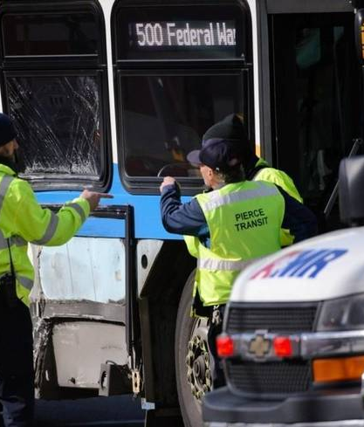
Post-Accident Scenarios
Passengers Injured When Truck Broadsides Transit Bus
A _______transit bus was broadsided by a tractor-trailer, injuring three bus passengers.
The injured passengers were taken to local hospitals.
According to law enforcement, the ______ bus was traveling eastbound on _____ through the intersection when the semi-truck ran a red light and collided with the bus.

Slide 33
Post-Accident Scenarios
Has a post-accident threshold been met?
Should the operator be tested?
Should anyone else be tested?

Slide 34
Post-Accident Scenarios

Slide 35
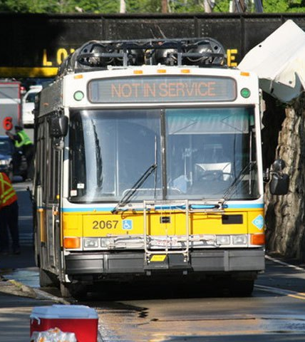
Post-Accident Scenarios
Roof Ripped Off _______ Bus in _______ Crash
The roof of the bus was ripped off when the driver tried to maneuver underneath a bridge. The accident ruptured the natural gas pipe that powered the bus, releasing thousands of pounds of gas into the air.
Fortunately, the bus driver was the only person on board.
No injuries were reported.

Slide 36
Post-Accident Scenarios
Has a post-accident threshold been met?
Should the operator be tested?
Should anyone else be tested?

Slide 37
Post-Accident Scenarios

Slide 38
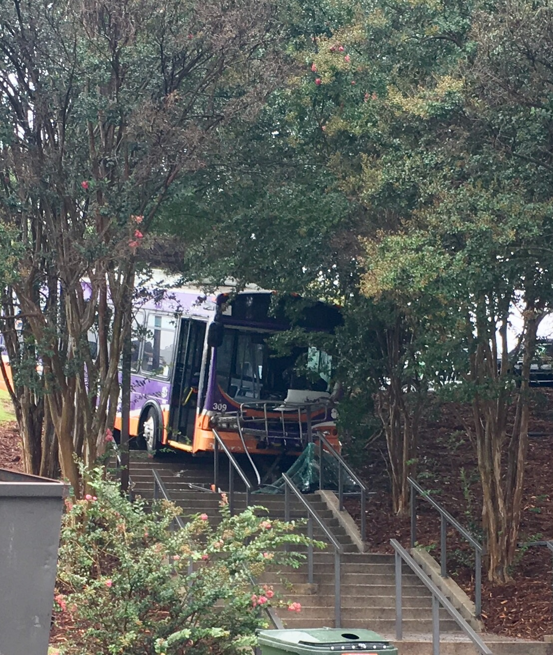
Post-Accident Scenarios
Transit Bus Crashes Down Stairs at Stadium
A _______transit bus crashed down a flight of stairs just outside of _______ Stadium.
Police say the crash was due to a mechanical failure.
Nobody was hurt in the crash.
There were no passengers on the bus at the time.

Slide 39
Post-Accident Scenarios
Has a post-accident threshold been met?
Should the operator be tested?
Should anyone else be tested?

Slide 40
Post-Accident Scenarios

Slide 41
Post-Accident Scenarios
Student Goes into Cardiac Arrest on Bus
Student suffered a heart issue that led to a seizure, along with oxygen deprivation.
EMS arrived and initiated resuscitation before the student was taken to _____ Health Center.

Slide 42
Post-Accident Scenarios
Has a post-accident threshold been met?
Should the operator be tested?
Should anyone else be tested?

Slide 43
Post-Accident Scenarios
655.4 Definitions
Accident means an occurrence associated with the operation of a vehicle, if as a result…

Slide 44
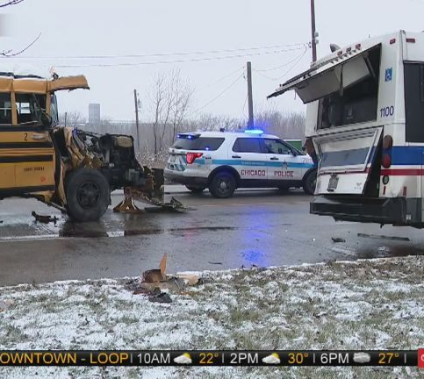
Post-Accident Scenarios
7 Hurt when School Bus Slips on Ice, Crashes into ______ Bus
A school bus with students on board hit the patch of ice and rear-ended the _____ bus, according to _____ fire and police officials.
The _____ bus was pushed forward and hit another vehicle.
Seven people were taken to area hospitals, all in good conditions.

Slide 45
Post-Accident Scenarios
Has a post-accident threshold been met?
Should the operator be tested?
Should anyone else be tested?

Slide 46
Post-Accident Scenarios

Slide 47
Post-Accident Scenarios
5 Killed During Head-On Crash Involving Car, _____ Transit Bus
Five people are dead and two others critically injured following a head-on crash involving a car and _______ bus in ________.
Police said the driver of a Nissan Sentra crossed the center line and crashed head-on into a ______ bus. The driver lost control and hit a tree.

Slide 48
Post-Accident Scenarios
Has a post-accident threshold been met?
Should the operator be tested?
Should anyone else be tested?

Slide 49
Post-Accident Scenarios

Slide 50
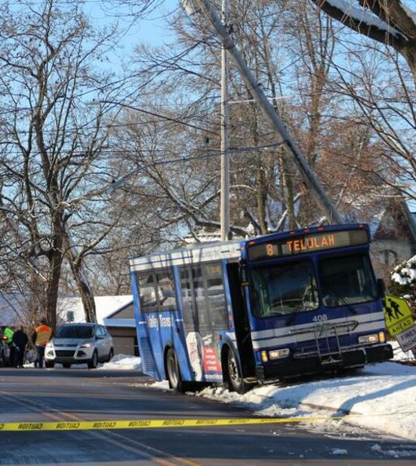
Post-Accident Scenarios
No One Hurt in _____ Bus Crash
No one was injured after _____ bus crashed into a utility pole. No injuries have been reported.
_______ says one of its buses ended up on the curb in the snow after hitting a pole.
_______ says the crash caused cosmetic damage to the bus.

Slide 51
Post-Accident Scenarios
Has a post-accident threshold been met?
Should the operator be tested?
Should anyone else be tested?

Slide 52
Post-Accident Scenarios

Slide 53
Post-Accident Scenarios
Bus Hits Moose
The _____ bus struck an animal – reported to be a moose by witnesses.
“I cannot confirm it was a moose, but the bus did hit an animal and there was fairly significant damage to the front of the bus.”
No one was injured in the crash.
The officers followed the [bus] as they drove down the road and switched the bus.
For decades, moose have been a rarity in the area, but began migrating back from Canada in the 1980’s.

Slide 54
Post-Accident Scenarios
Has a post-accident threshold been met?
Should the operator be tested?
Should anyone else be tested?

Slide 55
Post-Accident Scenarios

Slide 56
Resources
Post-Accident Testing Chart
Decision Making Form
Order Post-Accident Threshold Cards

Slide 57
Questions?
Trent Kenneth Fontanella Cahill Swift (617) 314-9208 ext. 6 tfontanella@cahillswift.com

