Slide 1
Testing for Small and Rural Transit Employers: Challenges and Best Practices Craig McNulty Cahill Swift FTA Drug and Alcohol Program National Conference May 12, 2021

Slide 2
Speaker
Craig McNulty – Cahill Swift, Boston, MA

Slide 3
Hurdles to Compliant Testing
Workload (and Records Storage)
Training
Unfavorable Geography
Qualified Service Agents
Testing Limitations

Slide 4
Hurdles to Compliant Testing
All resources discussed can be found (for free) at:
https://transit-safety.fta.dot.gov/DrugAndAlcohol/Tools/

Slide 5
Workload
Drug and alcohol program is buried.
Scarce resources
Management (sometimes) does not understand the importance.

Slide 6
Workload
Information sharing between departments.
Ensure necessary records are shared
Appropriately organized and secured files.
FTA’s record keeping requirements

Slide 7
Workload and Records Storage
What records do you keep?
Test results
Testing process administration
Return-to-duty process administration
Employee training
Supervisor training

Slide 8
Records Storage
Secure location with controlled access.
Your TPA may keep them.
Employer’s responsibility that they are current, saved, and secured correctly

Slide 9
Records Storage
One (1) Year:
Negative drug test results
Alcohol test results less than 0.02
Two (2) Years:
Education and training records
Records related to the alcohol and drug collection process
Three (3) Years:
Previous employer records
Five (5) Years:
Annual MIS reports
Employee evaluation and referrals to SAPs
Follow-up tests and follow-up schedules
Refusals to test
Alcohol test results 0.02 or greater
Verified positive drug test results

Slide 10
Training
DAPM was never trained.
Or received ineffective training
Only DAPM knows rules.
There is no backup

Slide 11
Training
Compliant policy.
Will help establish required baselines
Employee/supervisor training.
60-minute drug awareness
Reasonable Suspicion (60/60)
Post-Accident thresholds and timeframes
Display and distribution of materials.

Slide 12
Unfavorable Geography
Isolated location...
Or multiple remote locations
… which lead to specific random, post-accident, and reasonable suspicion testing difficulties.

Slide 13
Unfavorable Geography
Isolated location
Inability to locate “readily available” Substance Abuse Professionals (SAPs)

Slide 14
Find a Qualified SAP
Organizations approved by the Office of Drug and Alcohol Policy and Compliance (ODAPC)
National Association of Alcoholism and Drug Abuse Counselors Certification Commission (NAADAC)
https://www.naadac.org/sap-directory
International Certification Reciprocity Consortium (ICRC)
https://internationalcredentialing.org/memberboards
National Board for Certified Counselors (NBCC)
https://www.nbcc.org/search/counselorfind

Slide 15
Qualified Service Agents
Medical Review Officer (MRO)
Substance Abuse Professional (SAP)
Urine Collector
Screening Test Technician (STT)/Breath Alcohol Technician (BAT)
Collection Site

Slide 16
Qualified Service Agents
MRO
Check qualifications
Create easy reporting path
SAP
Check qualifications
Must have at least two “readily available” SAPs
Can use just a broker (as long as you have an agreement)

Slide 17
Qualified Service Agents
Urine Collectors, STTs, and BATs
Check qualifications
Proactively ask collection site to send over any new hire’s qualifications
Error correction training (when necessary)

Slide 18
Qualified Service Agents
Collection Site
Check if EBT is on conforming products list (CPL):
See ODAPC website: https://www.transportation.gov/odapc/Approved-Evidential-Breath-Measurement-Devices)
Stop by:
Check enclosure
Check the sign-in process (no collection site specific consent form)
Talk to manager, and/or collectors, and assure them it is ok to call you with any problem

Slide 19
Qualified Service Agents
Collection Site
Check incoming paperwork for errors
Fix when required
Note and file when completed
See if appointments are available

Slide 20
Testing Limitations
Random
Post-Accident
Reasonable Suspicion

Slide 21
Random Testing
Reasonable testing spread to include:
All times of the day that SS functions are performed
Outside of “administrative” hours
Early morning (especially alcohol) or late evening

Slide 22
Random Testing
Reasonable testing spread to include:
All days of the week that SS functions are performed
Weekends

Slide 23
Random Testing
Reasonable testing spread to include:
All weeks of the month
For monthly selections: ensure the timeliness of the selection list to include the first/last week of testing period

Slide 24
Random Testing
Reasonable testing spread to include:
All months of the year
For quarterly selections: ensure the timeliness of selection list to include first/last weeks of the testing period

Slide 25
Random Testing
Schedule tests ahead of time.
Collaborate with others:
Get help from supervisors to conduct tests on weekends, or outside regular work hours

Slide 26
Random Testing
After hours testing:
Hospital/Urgent Care
Ensure DOT qualified collectors
After-hours agreement with regular collection site
Agreement with an individual collector

Slide 27
Random Testing
Create your own random testing charts.
FTA Tools and Resources website
Update random pool before selection.
Share with others in case of absence
Reminder: At least 50% for drugs, 10% for alcohol.

Slide 28
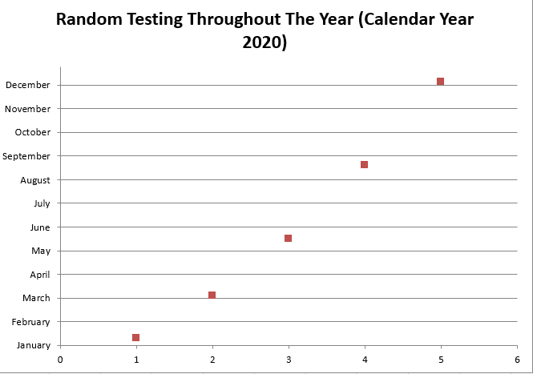
Random Testing System with 10 safety-sensitive employees:

Slide 29
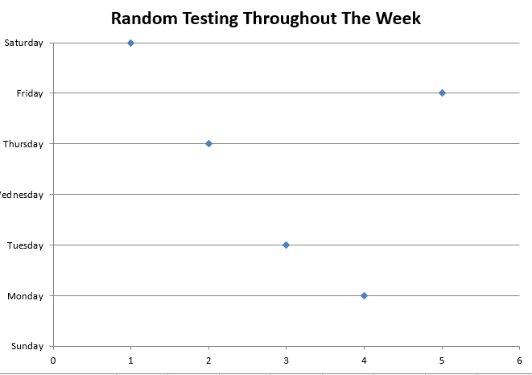
Random Testing System with 10 safety-sensitive employees:

Slide 30
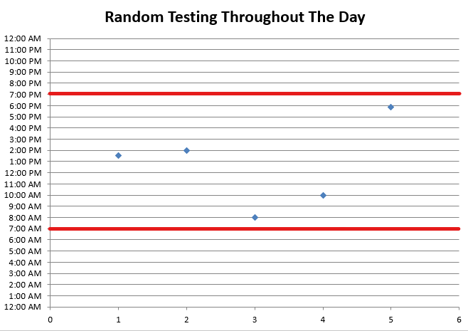
Random Testing System with 10 safety-sensitive employees:

Slide 31
Post-Accident
Establish decision making protocols.
DAPM
Dispatch
Employee immediately reports accident.
Interview employee over the phone.
Talk to law enforcement, if possible

Slide 32
Post-Accident
Take notes in real-time (or fill out form if you have one).
Walk employee through the steps.
If testing is required, send them immediately
Clock starts at the time of the accident
Not when you make your decision

Slide 33
Post-Accident
Aside from thresholds, and employees being tested, your documentation must include:
§655.44(a)(2)(ii): If an alcohol test required by this section is not administered within two hours following the accident, the employer shall prepare and maintain on file a record stating the reasons the alcohol test was not promptly administered. If an alcohol test required by this section is not administered within eight hours following the accident, the employer shall cease attempts to administer an alcohol test and maintain the record. Records shall be submitted to FTA upon request of the Administrator.

Slide 34
Post-Accident
Aside from thresholds, and employees being tested, your documentation must include:
§655.44(d): The decision not to administer a drug and/or alcohol test under this section shall be based on the employer's determination, using the best available information at the time of the determination that the employee's performance could not have contributed to the accident. Such a decision must be documented in detail, including the decision-making process used to reach the decision not to test.

Slide 35
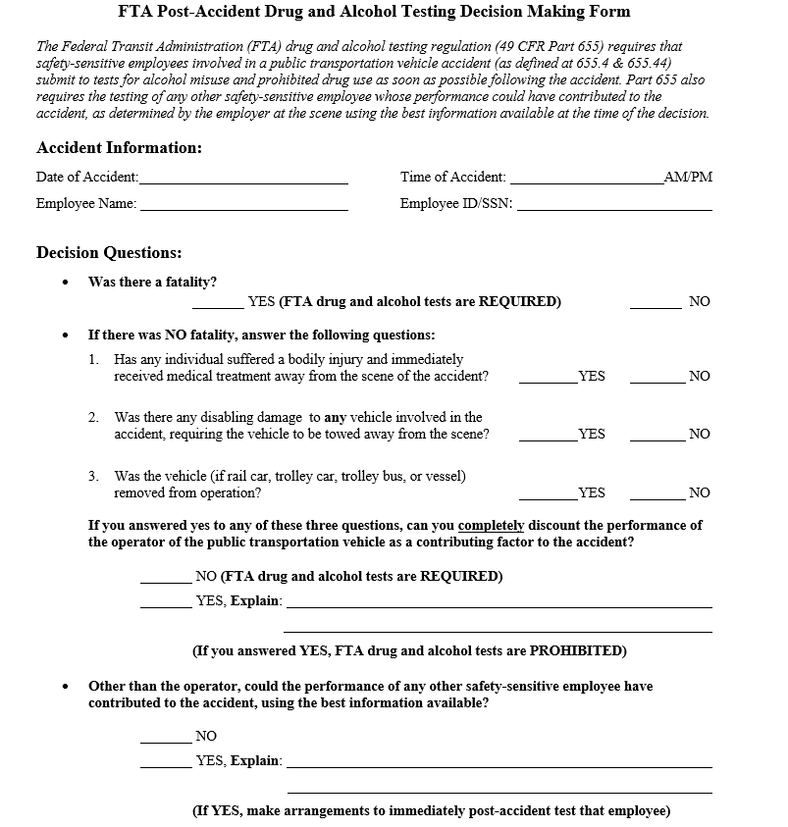
Sample Post-Accident Form

Slide 36
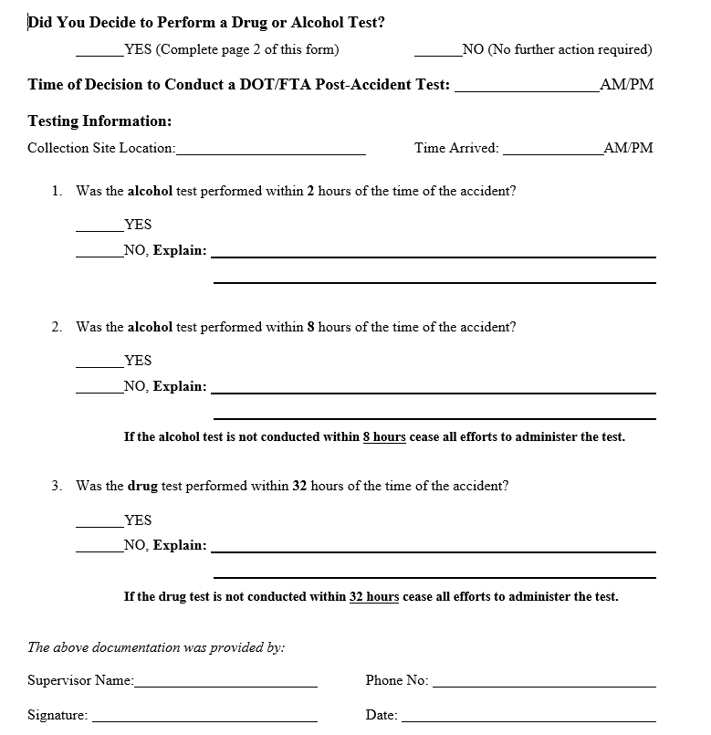
Sample Post-Accident Form

Slide 37
Reasonable Suspicion
Establish decision making protocols.
Must happen in real-time.
DAPM (or supervisor) must go to employee’s location.
Face-to-face

Slide 38
Reasonable Suspicion
Have employee cease performance of SS functions.
Document signs and symptoms of drug use and/or alcohol misuse upon arrival.
Employees (not authorized) should know who to contact if suspicious.

Slide 39
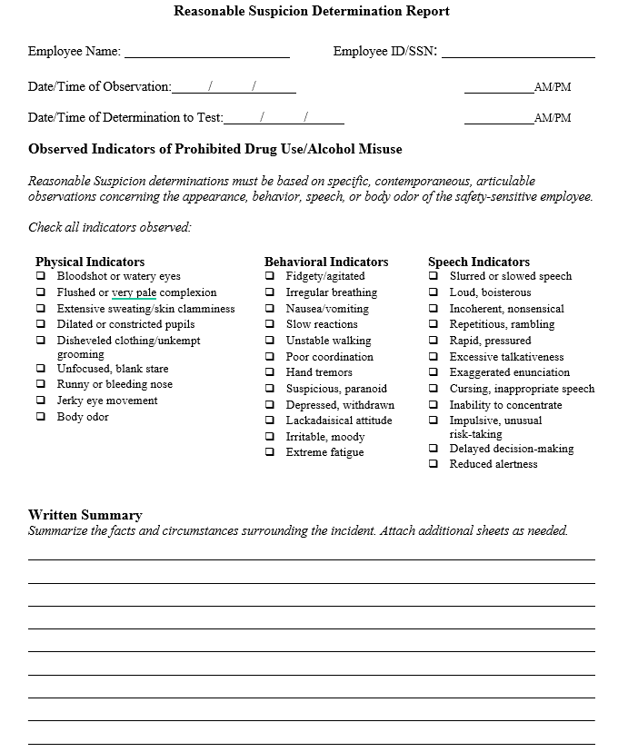
Sample Reasonable Suspicion Form

Slide 40
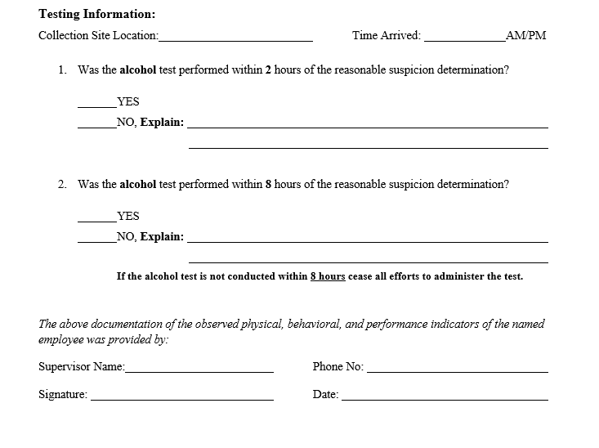
Sample Reasonable Suspicion Form

Slide 41
Reasonable Suspicion and Post-Accident Testing Site
If you are in a pinch:
§40.221(e): If an alcohol testing site fully meeting all the visual and aural privacy requirements of paragraph (c) is not readily available, this part allows a reasonable suspicion or post-accident test to be conducted at a site that partially meets these requirements. In this case, the site must afford visual and aural privacy to the employee to the greatest extent practicable.

Slide 42
Questions?
Craig McNulty Cahill Swift 617-314-9208 cmcnulty@cahillswift.com

